Slide 1
NYC Parking Tickets: An Exploratory Analysis (Big Data)
Group Name:
Deepak Aneja
Suresh Balla
Merin Jose
Fayiz Mayam Veettil
15 Jul 2018

Slide 2
Table of Contents
Reading data into S3 (screenshot of the S3 bucket of all four members)
Exploratory Data Analysis
Examine Data
Aggregation Tasks

Slide 3
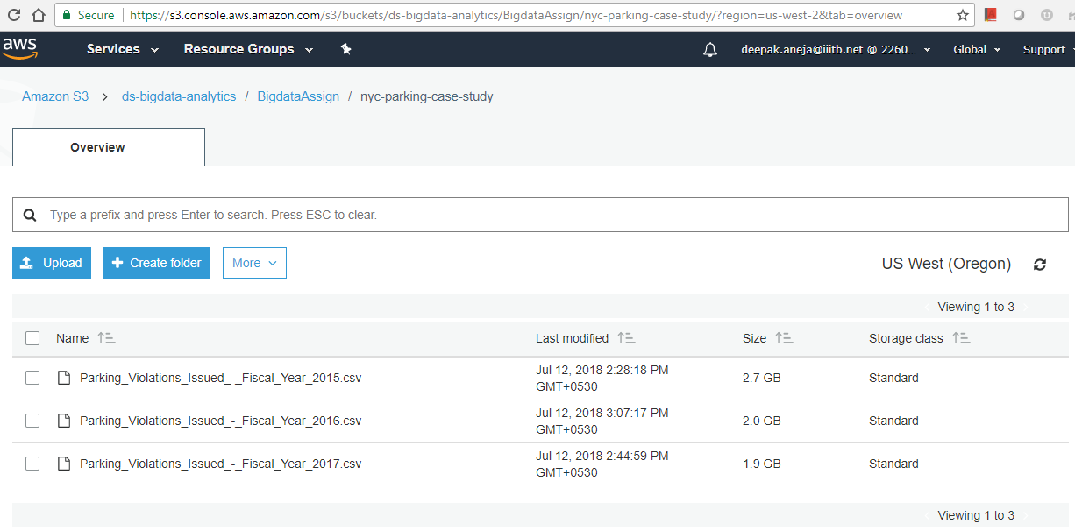
(Bucket Path : s3://fayiz-bigdata-assignment/nyc-parking-case-stud/)
S3 Bucket: Deepak Aneja (Bucket Path: s3://ds-bigdata-analytics/BigdataAssign/nyc-parking-case-study/)

Slide 4
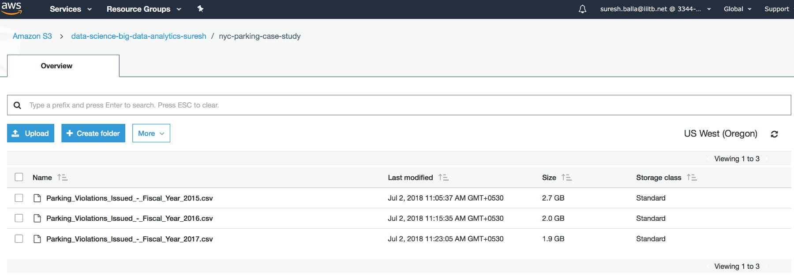
(Bucket Path : s3://fayiz-bigdata-assignment/nyc-parking-case-stud/)
S3 Bucket: Suresh Balla (Bucket Path: s3://data-science-big-data-analytics-suresh/nyc-parking-case-study/)

Slide 5
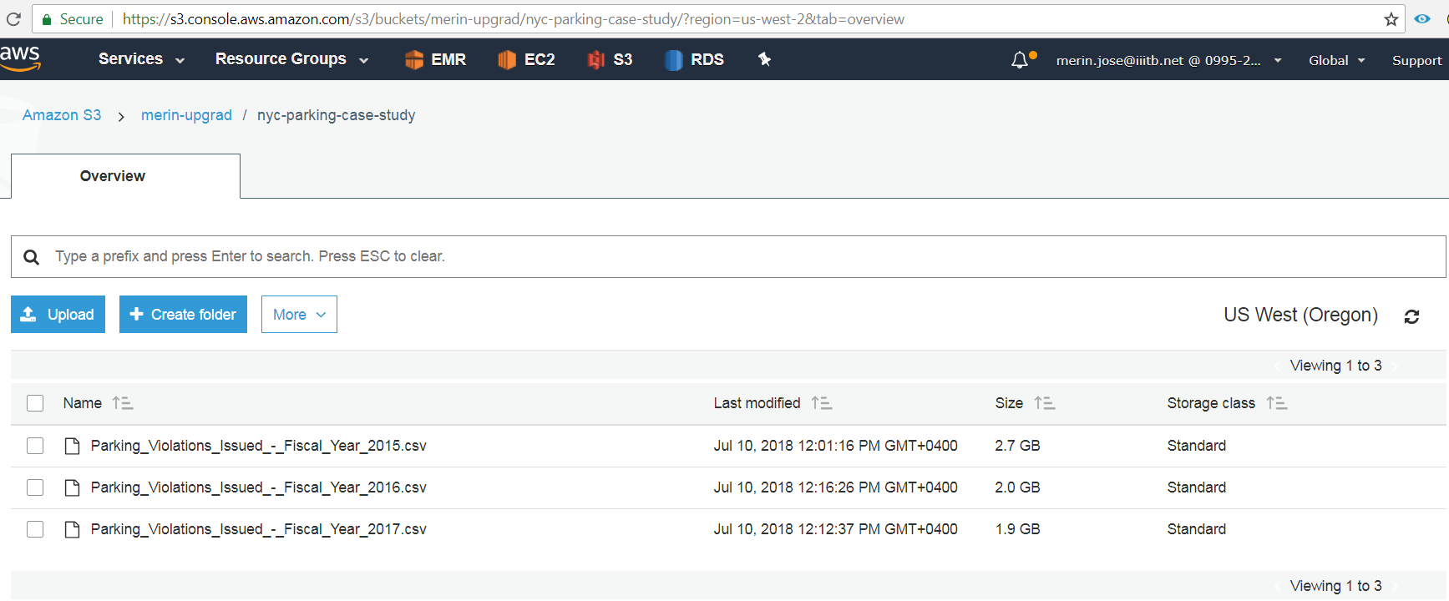
(Bucket Path : s3://fayiz-bigdata-assignment/nyc-parking-case-stud/)
S3 Bucket: Merin Jose (Bucket Path: s3://merin-upgrad/nyc-parking-case-study/)

Slide 6
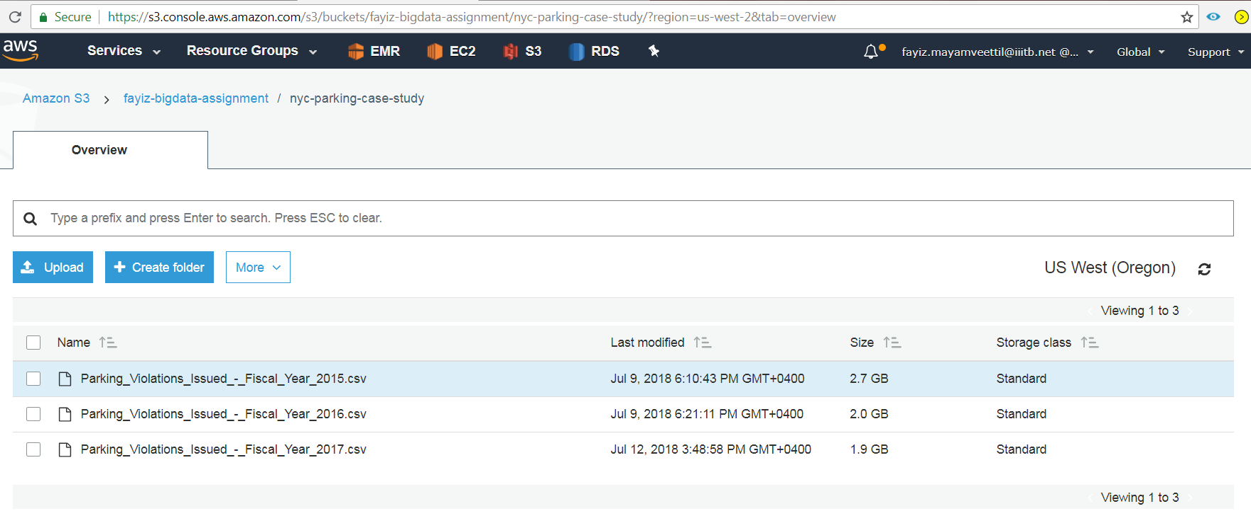
(Bucket Path : s3://fayiz-bigdata-assignment/nyc-parking-case-stud/)
S3 Bucket: Fayiz Mayam Veettil (Bucket Path: s3://fayiz-bigdata-assignment/nyc-parking-case-study/)

Slide 7
Exploratory Data Analysis
Check for possible data inconsistencies
Check for duplicate records
Check for NA values in the columns used for analysis
Status of data cleaning
--

Slide 8
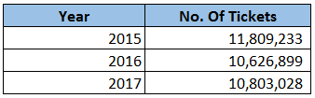
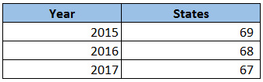
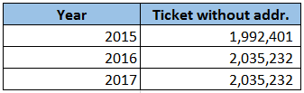
Examine the data
1. Find total number of tickets for each year.
2. Find out how many unique states the cars which got parking tickets came from.
3. Some parking tickets don’t have addresses on them, which is cause for concern. Find out how many such tickets there are.

Slide 9
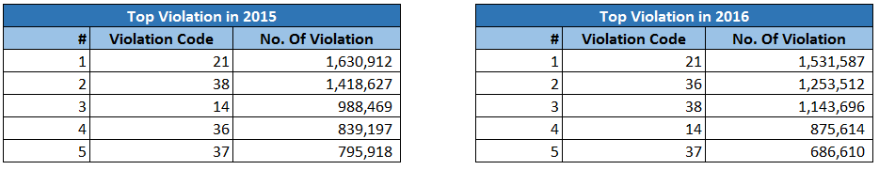
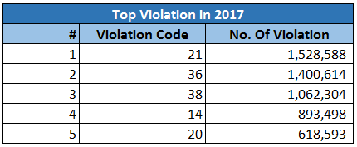
Aggregation Tasks
1. How often does each violation code occur? (frequency of violation codes - find the top 5)

Slide 10
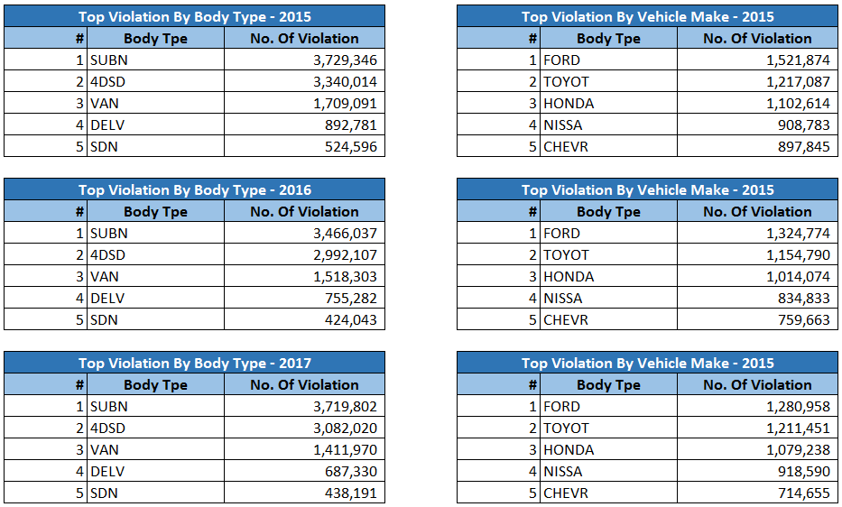
Aggregation Tasks
2. How often does each vehicle body type get a parking ticket? How about the vehicle make? (find the top 5 for both)

Slide 11
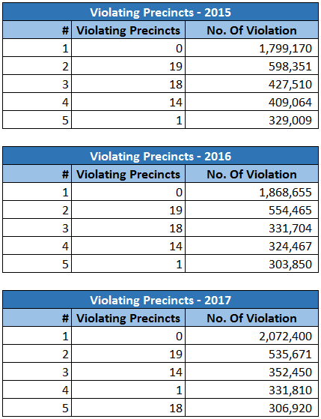
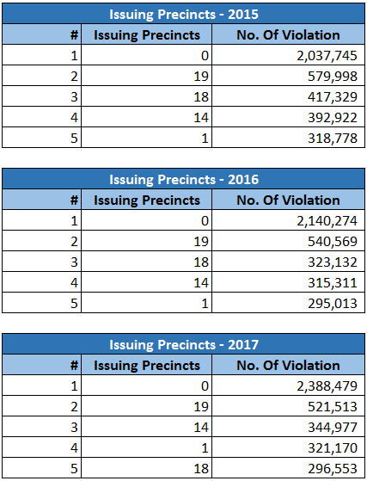
Aggregation Tasks
3. A precinct is a police station that has a certain zone of the city under its command. Find the (5 highest) frequencies of:
Violating Precincts (this is the precinct of the zone where the violation occurred)
Issuing Precincts (this is the precinct that issued the ticket)

Slide 12
Aggregation Tasks
4. Find the violation code frequency across 3 precincts which have issued the most number of tickets - do these precinct zones have an exceptionally high frequency of certain violation codes? Are these codes common across precincts?

Slide 13
Aggregation Tasks
You’d want to find out the properties of parking violations across different times of the day:
The Violation Time field is specified in a strange format. Find a way to make this into a time attribute that you can use to divide into groups.
Find a way to deal with missing values, if any.
Divide 24 hours into 6 equal discrete bins of time. The intervals you choose are at your discretion. For each of these groups, find the 3 most commonly occurring violations
Now, try another direction. For the 3 most commonly occurring violation codes, find the most common times of day (in terms of the bins from the previous part)

Slide 14
Aggregation Tasks
6. Let’s try and find some seasonality in this data
First, divide the year into some number of seasons, and find frequencies of tickets for each season.
Then, find the 3 most common violations for each of these season

Slide 15
Aggregation Tasks
6. The fines collected from all the parking violation constitute a revenue source for the NYC police department. Let’s take an example of estimating that for the 3 most commonly occurring codes.
Find total occurrences of the 3 most common violation code
Then, search the internet for NYC parking violation code fines. You will find a website (on the nyc.gov URL) that lists these fines. They’re divided into two categories, one for the highest-density locations of the city, the other for the rest of the city. For simplicity, take an average of the two.
Using this information, find the total amount collected for all of the fines. State the code which has the highest total collection.
What can you intuitively infer from these findings?

